Slide 1
Symposium: Diagnostics for Impact POC VL Testing to
facilitate Differentiated HIV Care
in South Africa
Dr Nigel Garrett
Head of Pathogenesis and Vaccine Research
AIDS 2018
Amsterdam, 23 July 2018

Slide 2
Disclosures
Cepheid Inc. kindly loaned the CAPRISA study team two 4-module GeneXpert® instruments and supplied Xpert® HIV-1 VL cartridges at reduced cost.

Slide 3
Outline
Progress towards ‘90-90-90’ in South Africa
Meeting the challenge through ‘Differentiated Care’
The potential of point-of-care viral load testing in Differentiated Care
The STREAM trial: Simplifying HIV TREAtment & Monitoring with POC VL testing
Key lessons learnt so far, and way forward

Slide 4
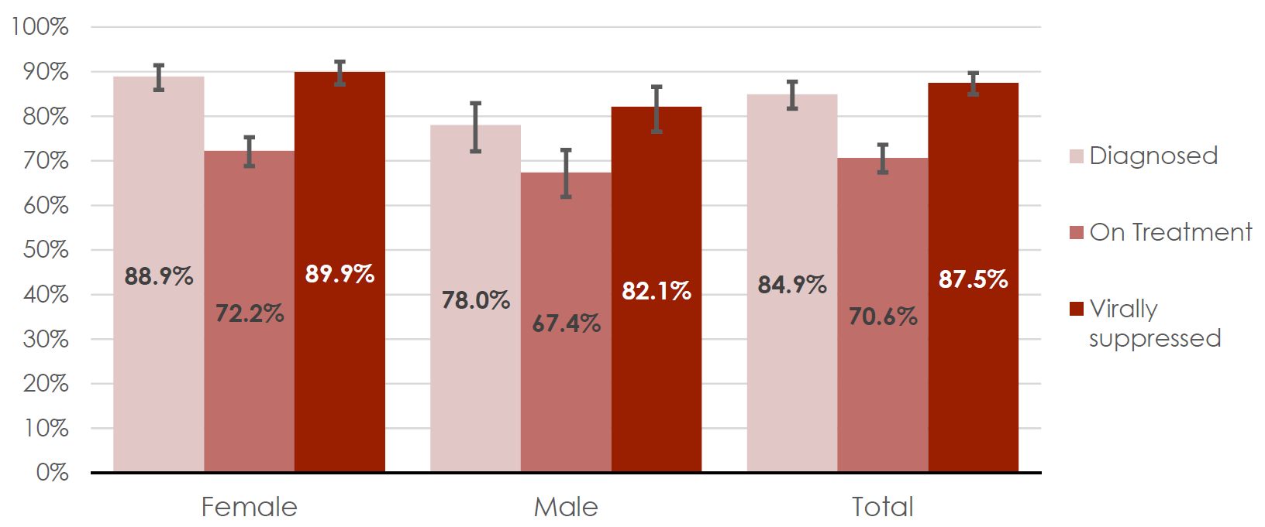
South Africa makes progress towards 90-90-90 (2017 data)
Total 7.9 million PLHIV
20.6% prevalence (15 – 49 year-old)
...but up to 50% of PLHIV never receive a VL result.
1. HSRC 5th South African National HIV Prevalence, Incidence, Behaviour and Communication Survey, 2017;
2. Bor et al. Towards 90-90-90. How close is South Africa to reaching the UNAIDS treatment targets? 2016

Slide 5
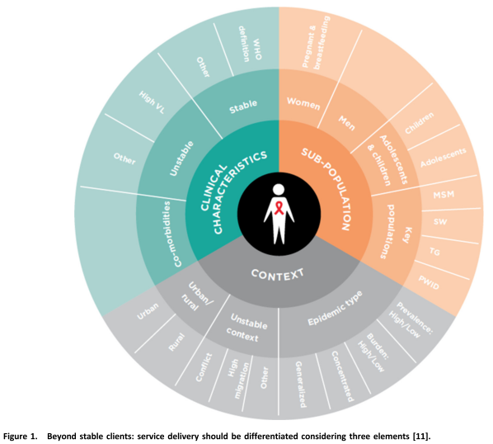
Differentiated Care for HIV Tailor-made services rather than ‘one size fits all’!
IAS. Differentiated care for HIV: a decision framework for antiretroviral therapy delivery. Durban; 2016

Slide 6
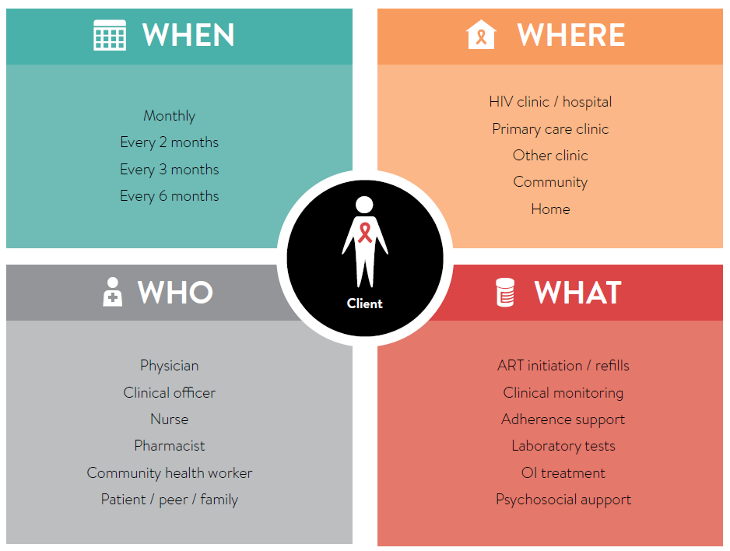
Differentiated care The building blocks
IAS. Differentiated care for HIV: a decision framework for antiretroviral therapy delivery. Durban; 2016.

Slide 7
POC VL testing & Differentiated Care
Point-of-care viral load testing and differentiated HIV care
J Dorward, PK Drain, N Garrett.
Potential advantages:
Quicker triage into stable/unstable care pathways
Reduced visits for blood draws and results
Quicker clinical decision making
Reduced specimen transport
Results less likely to be lost
Potential disadvantages:
Less high throughput
Quality assurance at decentralized sites
Supply chain for consumables and reagents
1. J Dorward, et al. LANCET HIV. 2018; 2. IAS, 2016

Slide 8
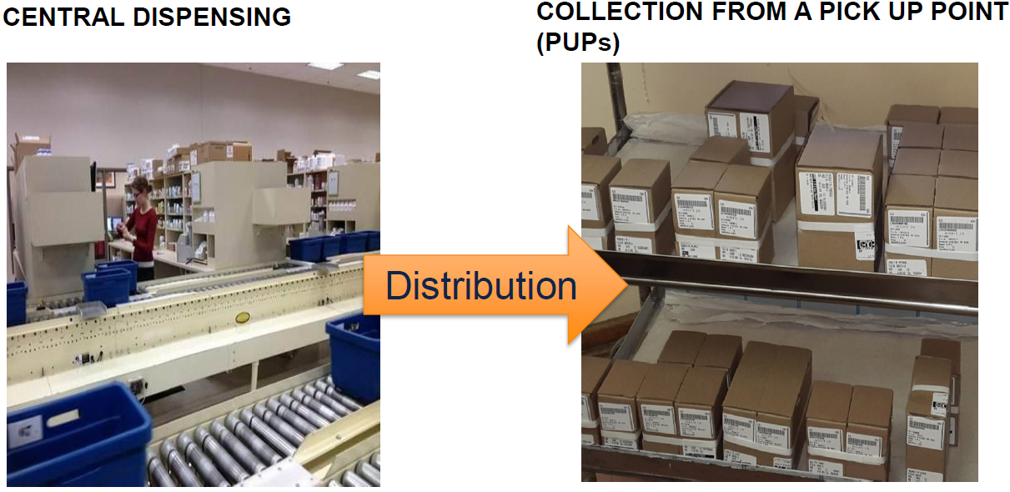
Opportunities for Differentiated Care in SA Central Chronic Medicine Dispensing & Distribution Programme (CCMDD)
2-monthly community pharmacy ART collection with 6-monthly clinic review (eligible if VL suppressed at 12 months)
POC VL could allow earlier entry into CCMDD
POC VL could reduce clinic visits by 33-50%, as no need for blood draw prior to clinical review
Central dispensing
ART pick-up points
Zeeman, H. CCMDD: A vehicle towards universal access to ART in South Africa. HST Conference 2016

Slide 9
A model of Differentiated Care using enrolled nurses, POC VL & CCMDD
J Dorward, et al. BMJ Open. 2017

Slide 10
The STREAM Trial
Protocol for a randomised controlled implementation trial of POC VL testing and task shifting: the STREAM study
J Dorward, N Garrett, J Quame-Amaglo, et al. 2017
Design: Open-label, randomized controlled implementation trial
Setting: Prince Cyril Zulu CDC clinic, Durban
Eligibility: Non-pregnant adults on first-line ART for 6 months and due 6-month VL
Outcome: Retained in care and virologically suppressed after 12 months

Slide 11
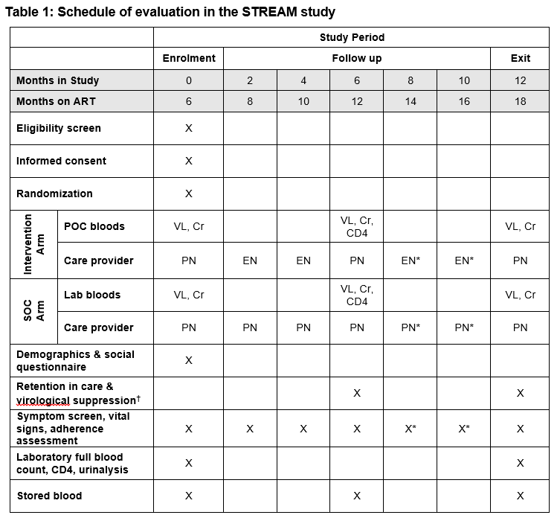
The STREAM Trial Simplifying HIV TREAtment and Monitoring using Xpert HIV-1 VL
Notes:
I thought this is

Slide 12
Study Update
Timeline
330/ 390 participants completed follow up to date
Last participant to exit by Sept 2018
Primary outcome analysis by Nov 2018
Xpert® HIV-1 VL
586 tests performed to date in STREAM
3.6% invalid/error rate
> 95% of results given to patient on the same day
~ 2h15mins from blood draw to result with patient

Slide 13
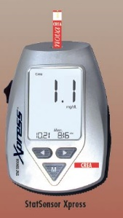
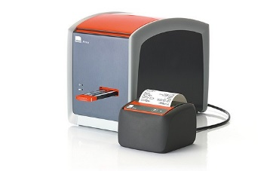
Lesson 1: Need to validate & integrate POC tests
Diagnostic Accuracy of the POC Xpert HIV-1 VL Assay in a South African HIV Clinic
NJ Garrett, PK Drain, L Werner , N Samsunder, SS Abdool Karim. 2015
Clinic-Based Evaluation of a POC Creatinine Assay to Screen for Renal Impairment Among HIV-Positive Patients Receiving TDF
J Dorward, N Yende-Zuma, N Samsunder, QA Karim, PK Drain, N Garrett. 2017
GeneXpert® System
& Xpert® HIV-1 VL
PIMATM POC CD4
(Alere)
Statsensor® Xpress-i POC Creatinine meter (Nova Biomedical)
POC Creatinine data
If POC VL testing, it’s best to offer all essential tests POC!

Slide 14
Lesson 2: Address inefficient clinic flow
Clinic flow for STI, HIV, and TB patients in an urban infectious disease clinic offering POC testing services in Durban, South Africa
KJ Stime, N Garrett, Y Sookrajh, J Dorward, N Dlamini, A Olowolagba, M Sharma, R Barnabas, P Drain. 2018
Time-in-motion studies (N=121)
Up to 7 queues with average stable HIV patient wait 2:42
Clinical assessment time 7 min
Rapid TB test (Xpert MTB/RIF): 40% did not receive result on same day.
Staff identified poor clinic flow and personnel shortages as challenges to expanding POC testing.

Slide 15
Lesson 3: Task-shifting can be glamorous, but...
Task shifting
When task-shifting from professional to enrolled nurses, consider other services that need to be provided:
Prescribing TB prophylaxis
Managing NCDs
Offering contraception & Pap smears
Address training needs
HIV management course
Prescribing course

Slide 16
Lesson 4: ‘Listen to your patients’ In-depth Interviews with STREAM participants (N=24)
‘It’s a good method because they take bloods from you and you wait for your VL and CD4 results and know…whether the treatment works.’
‘First time I went to pharmacy…it didn’t take more than 5 min...my medication was prepared already. Everything is just perfect and fast.’
‘What is good about POC testing is that you leave knowing that you need to fix that issue, if there is anything to fix.’

Slide 17
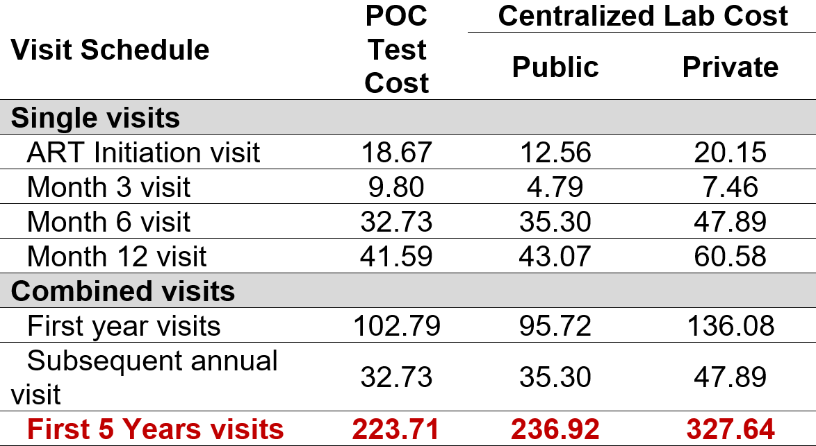
Lesson 5: POC monitoring could save costs!
WHO-recommended schedule on ART
Test costs, excluding equipment & maintenance costs
(2017 US$)

Slide 18
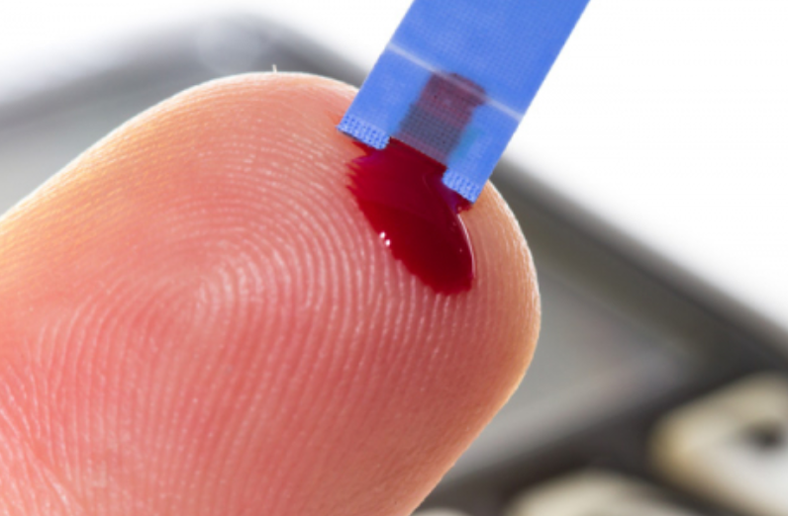
Next steps and future directions
Primary analysis on combined outcome (retention in care & virological suppression) at 12 months
Cost-effectiveness analysis
Explore utility of POC VL testing to detect & manage patients failing therapy
Integrate POC solutions (e.g. VL, drug level & resistance testing)
Advance finger-stick technology
Xpert HCV VL test, UNSW Website

Slide 19
Conclusions
90-90-90 remains a challenge, but Differentiated Care will play an important role to reach targets.
STREAM will shine a light on whether POC VL can facilitate Differentiated Care.
Implementation will likely require integration of POC solutions and efficient care pathways to maximize patient benefit and reduce cost.

Slide 20
Acknowledgements
Study participants
Co-PI Paul Drain & UW team
Ruanne Barnabas
Justice Quame-Amaglo
Katrina Stime & Kate Simeon
Ethekwini Municipality
Ntuthu Dlamini
Yukteshwar Sookrajh
Hope Ngobese
Prince Cyril Zulu CDC staff
Cepheid Inc.
Gwynn Stevens and team
Jienchi Dorward & the STREAM team
Funders:

